Slide 1

By: Darius Grasseschi, Evan Hassan, Jonathan Lacoursiere, Ariana Lee, Maria Medina, Spenser Solys, and Cody Trombley

Slide 2
Sprint 5 Objectives
Catch up on Sprint Backlog
Complete Following Requirements
FR.20 The system shall allow users to view previous game history.
FR.21 The system should provide detailed game statistics.
FR.22 The system shall track weekly League Points earned by a team.
FR.23 The system shall retroactively update points and standings when rules are changed.
Update UI Design / Map Integration

Slide 3
Sprint 6 Requirements
From Backlog:
FR.21 The system should provide detailed game statistics.
FR.23 The system shall retroactively update points and standings when rules are changed.
Feature Implementation:
FR 27. LB shall be able to view personal game history
FR 28. LB should be provided detailed game statistics.

Slide 4
User Stories
Req. Num. | User Story | Use Case
FR.20 | As a Bowler, I can view my previous game history. | UC20
FR.21 | As a Bowler, I can see some detailed game statistics. | UC21
FR.22 | As a Bowler, I can see League Points earned by a team. | UC22
FR.23 | As a League Secretary, I can change the bowling rules and points will update accordingly. | UC23

Slide 5
Sprint Challenges
Django Formsets
Displaying and updating data from multiple database sources in different formsets was a challenging learning curve
Page Design/Layout
Creatively organizing and displaying data for users in a way that looks clean and is user-friendly

Slide 6


Slide 7
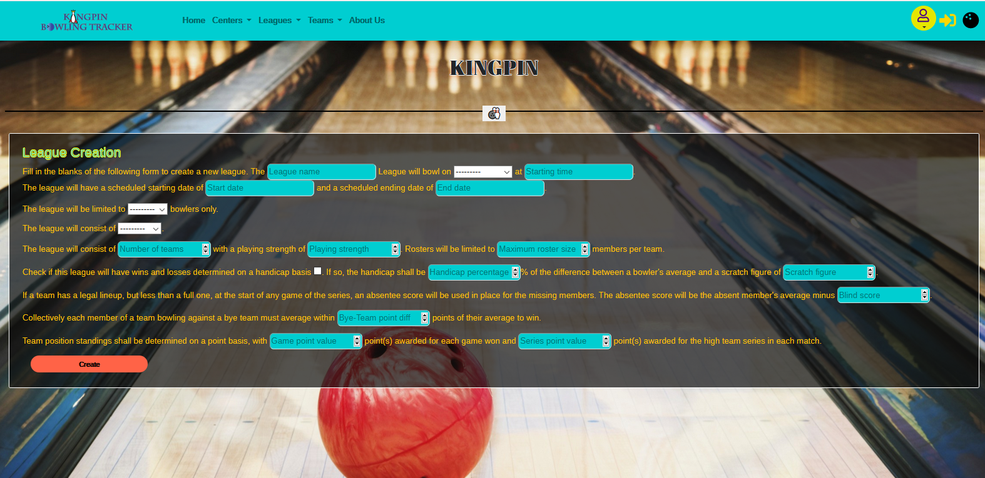

Slide 8
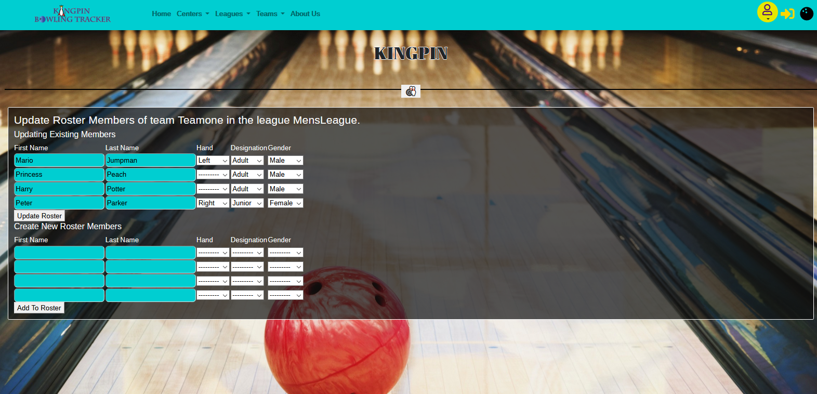

Slide 9
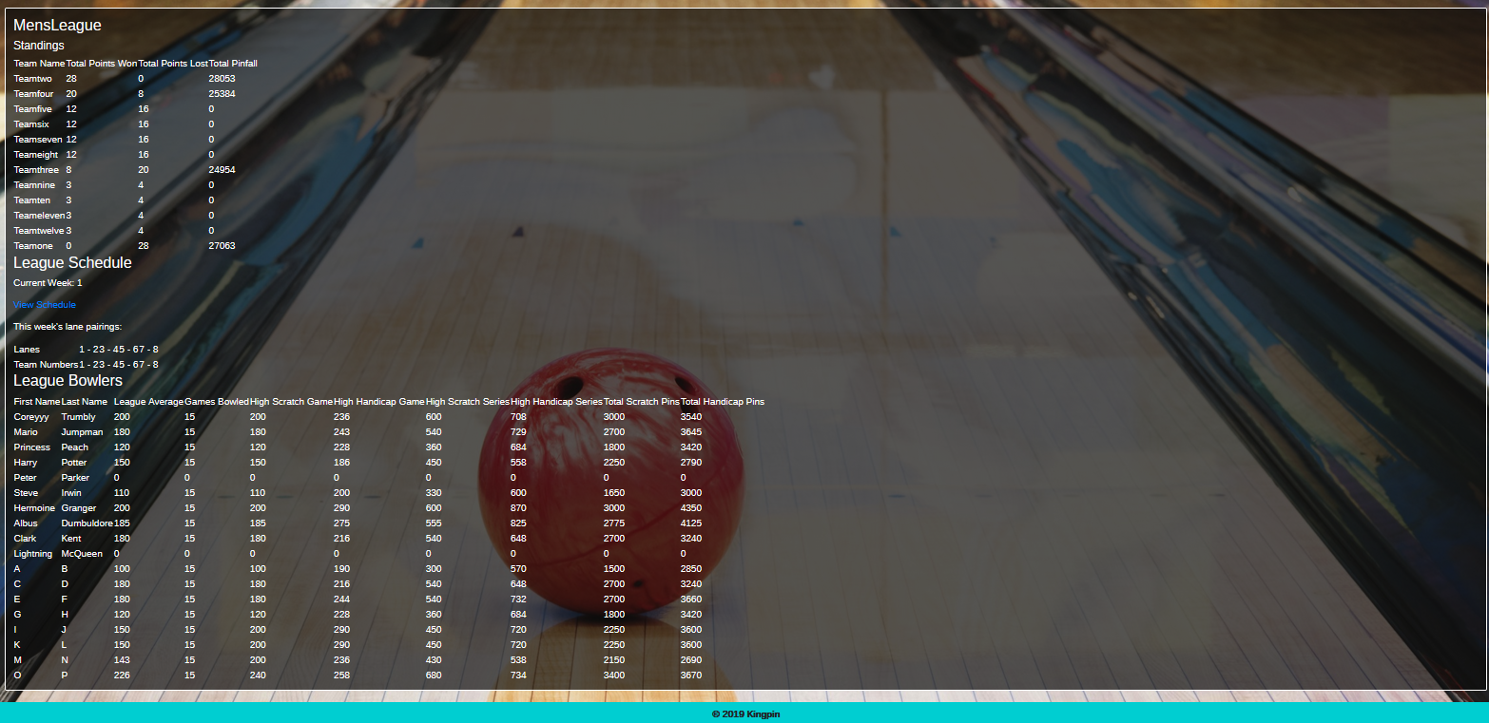

Slide 10
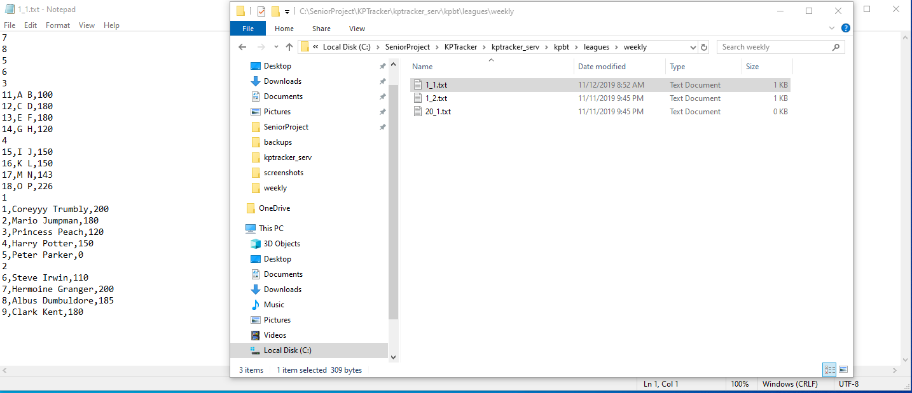

Slide 11
Next Sprint Objectives
Remaining few Functional Requirements
UI Design Styling
Documentation for Sprint 6
Use Case Diagram
Sequence Diagrams
Activity Diagrams
Execution Plan

Slide 12


THANK YOU
Any Questions?

